Slide 1
ECE6980
An Algorithmic and Information Theoretic Toolbox for Massive Data

Slide 2
Logistics
Instructor: Jayadev Acharya
Email: acharya@cornell.edu
Lectures: TuTh 1.25-2.40, 203 Phillips
Office Hours: MoTh 3-4, 304 Rhodes
Website: http://people.csail.mit.edu/jayadev/ece6980

Slide 3
Grading
Scribe a lecture: 10%
  Encouraged to fill in the details, provide examples
Assignments 30-60%
  2-3 assignments
  Typeset?
Project report and presentation: 40-60%
  Read a new related paper
  Present a summary in your own words
  Can choose from a list
Interruptions: 5%

Slide 4
Lectures
Lectures primarily on the board
Derive things (mostly from scratch)

Slide 5
Course overview
Lot of interest in data science
  Number of courses on offer
  Many aspects can be covered
This course:
  Core primitives
  Efficient algorithms
  Fundamental limits
  Mostly theoretical, encourage implementation

Slide 6
Prerequisites
Undergraduate probability/random processes
Basic combinatorics
What is the variance of a random variable?
What is a binomial distribution?
When are two random variables independent?

Slide 7
What you should learn?
Fast algorithms for statistical problems
  Learning discrete distributions
  Finite sample hypothesis testing
How to prove information theoretic lower bounds
Probabilistic thinking

Slide 8
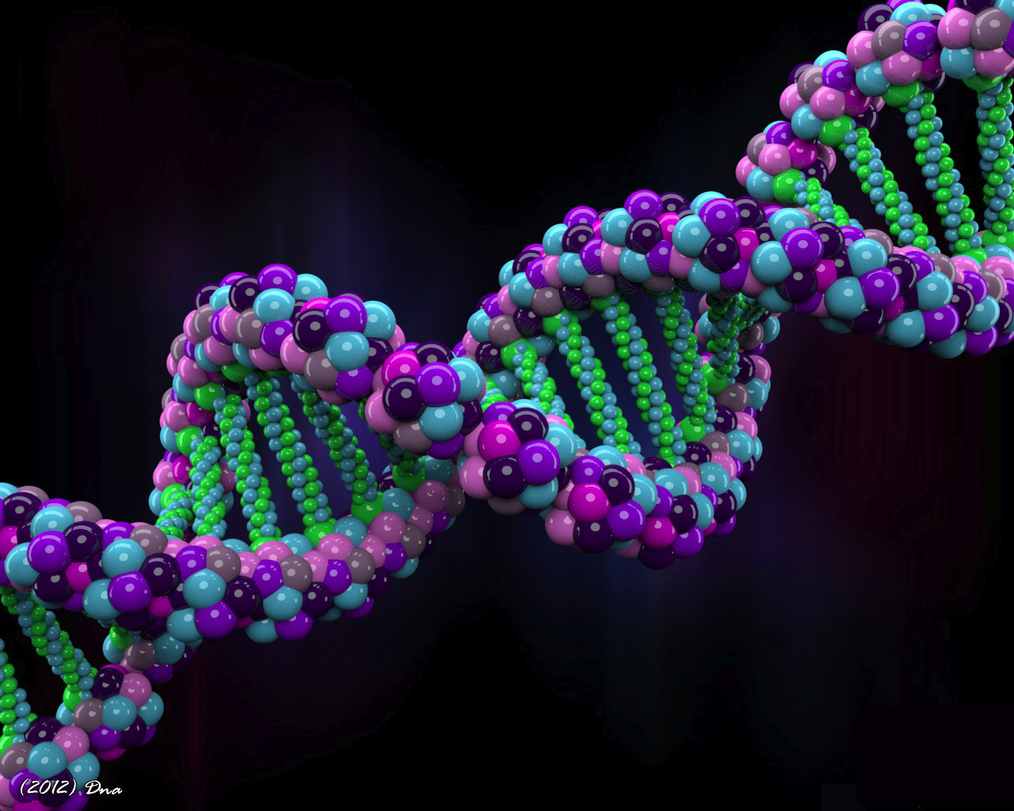
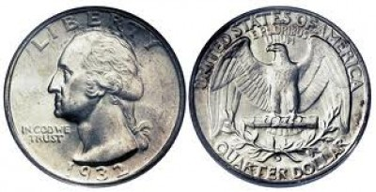
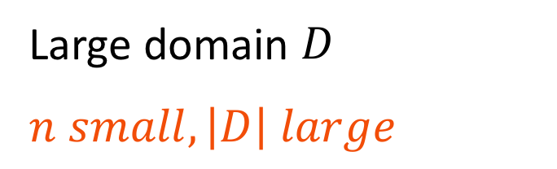
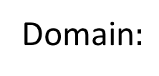

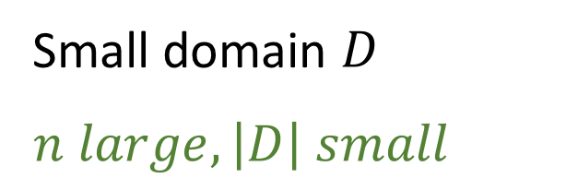
Old questions, new issues
Classical
Modern
Domain$:$
Domain:
$n=1000$ tosses
One human genome
Small domain $D$
$n large, \left|D\right| small$
Large domain $D$
$n small, \left|D\right| large$
Asymptotic analysis
Computation not crucial
New challenges

Slide 9
Resources
Samples
  How much data needed?
  Inference when data is scarce
Computation
  How does run-time scale with data and domain size?
  Even quadratic might be prohibitive
Other resources
  Storage: Not enough space to store all data
  Communication: Distributed data across servers

Slide 10
Goals
For statistical inference
Design efficient algorithms
Understand fundamental limits
STATISTICS
MACHINE LEARNING
INFORMATION THEORY
ALGORITHMS

Slide 11
Distribution learning

Slide 12
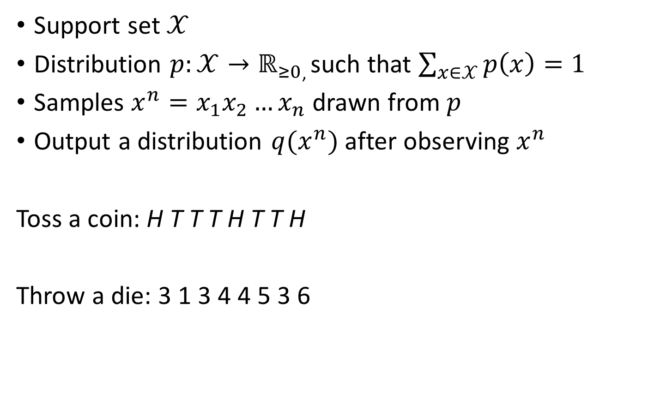
A simple setting
Support set $𝒳$
Distribution $p:𝒳→ℝ_{≥0}$, such that $\sum_{x∈𝒳}{p\left(x\right)}=1$
Samples $x^{n}=x_{1}x_{2}…x_{n}$ drawn from $p$
Output a distribution $q(x^{n})$ after observing $x^{n}$
Toss a coin: H T T T H T T H
Throw a die: 3 1 3 4 4 5 3 6

Slide 13
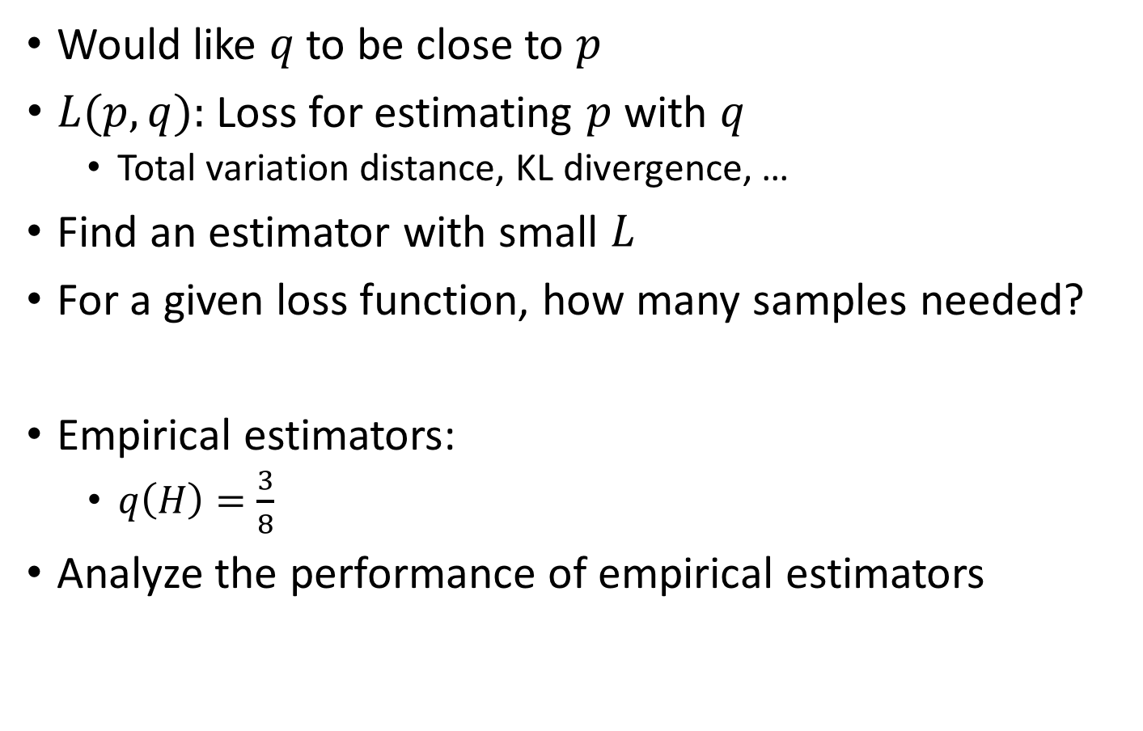
What is a good estimator
Would like $q$ to be close to $p$
$L(p,q):$Loss for estimating $p$ with $q$
  Total variation distance, KL divergence, …
Find an estimator with small $L$
For a given loss function, how many samples needed?
Empirical estimators:
  $q\left(H\right)=\frac{3}{8}$
Analyze the performance of empirical estimators

Slide 14

Learning
Given samples from a Gaussian distribution $N(μ,σ^{2})$
Learn with a Gaussian distribution
Relatively simple

Slide 15
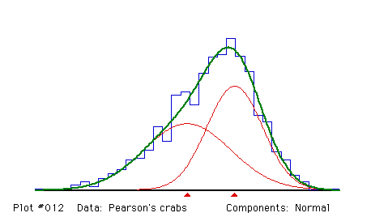
Learning
Ratio of breadth to height of 1000 crabs by W. Weldon
Not normally distributed, more than one species?
Karl Pearson: Mixtures of Gaussians (much harder!!)

Slide 16
Distribution testing

Slide 17
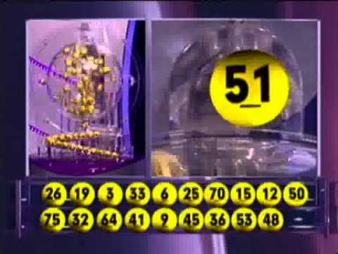
Testing uniformity
Polish Multilotek:
Picks 20 numbers between 1,…,80
Is it fair?
￼
￼
￼

Slide 18
Testing uniformity (contd)
(Figure by Onak, Price, Rubinfeld)

Slide 19
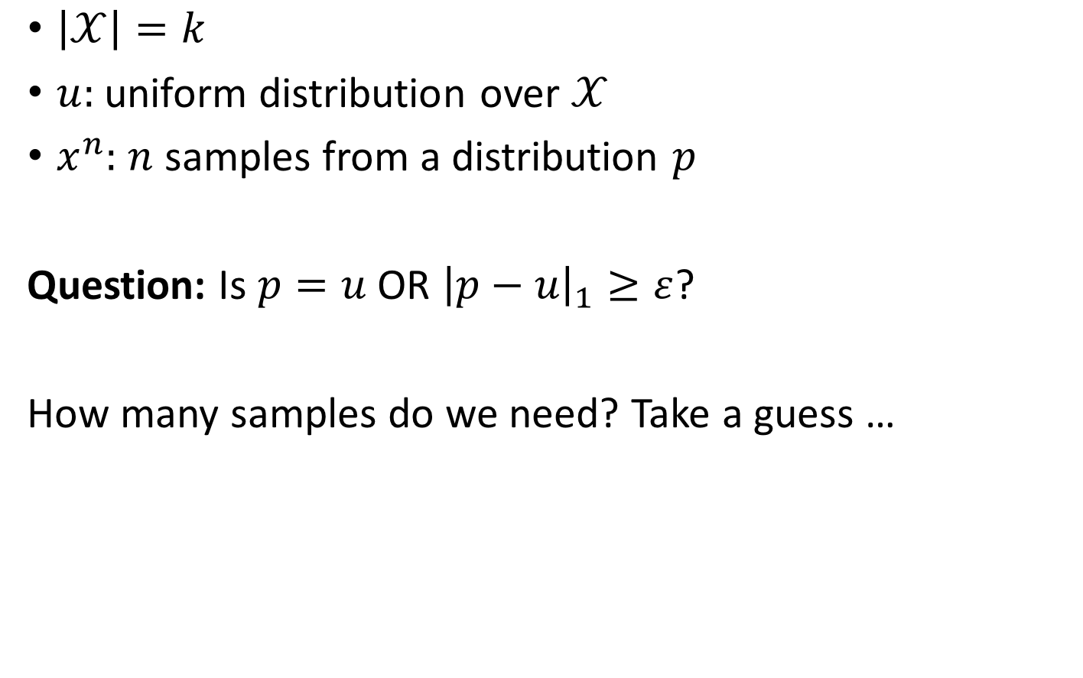
A simple setting
$\left|𝒳\right|=k$
$u:$ uniform distribution over $𝒳$
$x^{n}:$ $n$ samples from a distribution $p$
Question: Is $p=u$ OR ${\left|p−u\right|}_{1}≥ε$?
How many samples do we need? Take a guess …

Slide 20
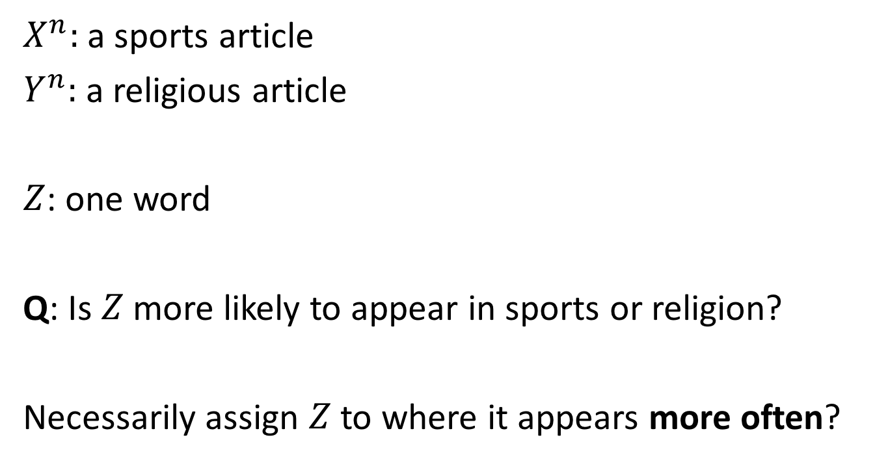
A simple classification problem
$X^{n}:$ a sports article
$Y^{n}:$ a religious article
$Z$: one word
Q: Is $Z$ more likely to appear in sports or religion?
Necessarily assign $Z$ to where it appears more often?
￼
￼
￼

Slide 21
Property estimation

Slide 22
Predicting new elements
. . .
How many new species?
Corbet collected butterflies in Malaya for one year
How many new species if he goes for one more year?

Slide 23
Entropy estimation
How much randomness in neural spikes?
How to estimate entropy from observations?

Slide 24

Entropy estimation
$\left|𝒳\right|=k$
$x^{n}:$ $n$ samples from a distribution $p$
Question: Estimate $H(p)$

Slide 25
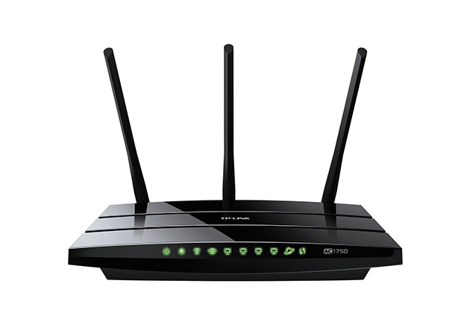

Resource constraints
distributed data
sample stream
decision
limited memory
  limited communication
Data too big to be stored in a single machine
Lot of recent interest

