Slide 1
2D Coordinates
$\left(x_{a},y_{a}\right),\left(x_{b},y_{b}\right)$ represent coordinates of two locations
Each coordinate is an $l$-bit unsigned number
$$x_{a}=x_{al}…x_{a2}x_{a1}$$
$$y_{a}=y_{al}…y_{a2}y_{a1}$$
$$x_{b}=x_{bl}…x_{b2}x_{b1}$$
$$y_{b}=y_{bl}…y_{b2}y_{b1}$$
$$Manhattan Distance =\left|x_{b}−x_{a}\right|+\left|y_{b}−y_{a}\right|$$

Slide 2
Calculating Absolute Difference
$$x_{al}$$
$$x_{bl}$$
$$x_{a2}$$
$$xb2$$
$$x_{a1}$$
$$xb1$$
SUB block is composed of $l$ 1-bit subtractors [Kolesnikov ’09]
Each 1-bit subtractor is composed of 4 XOR gates, 1 AND gate
Note: $x_{l+1}$ equals complement of carryout bit from $l^{th}$ 1-bit subtractor
INV block is composed of $l$ XOR gates
$\hat{x_{l}}…\hat{x_{2}}\hat{x_{1}}=\left|x_{b}−x_{a}\right|−x_{l+1}$
$$SUB$$
$$x_{l+1}$$
$$x_{l}$$
$$x_{2}$$
$$x_{1}$$
$$INV$$
$$\hat{x_{l}}$$
$$\hat{x_{2}}$$
$$\hat{x_{1}}$$

Slide 3
Calculating Absolute Difference
$$x_{al}$$
$$x_{bl}$$
$$x_{a2}$$
$$xb2$$
$$x_{a1}$$
$$xb1$$
$$y_{al}$$
$$y_{bl}$$
$$y_{a2}$$
$$yb2$$
$$y_{a1}$$
$$yb1$$
$$SUB$$
$$SUB$$
$$x_{l+1}$$
$$x_{l}$$
$$x_{2}$$
$$x_{1}$$
$$y_{l+1}$$
$$y_{l}$$
$$y_{2}$$
$$y_{1}$$
$$INV$$
$$INV$$
$$\hat{x_{l}}$$
$$\hat{x_{2}}$$
$$\hat{x_{1}}$$
$$\hat{y_{l}}$$
$$\hat{y_{2}}$$
$$\hat{y_{1}}$$
$$\hat{x_{l}}…\hat{x_{2}}\hat{x_{1}}=\left|x_{b}−x_{a}\right|−x_{l+1}$$
$$\hat{y_{l}}…\hat{y_{2}}\hat{y_{1}}=\left|y_{b}−y_{a}\right|−y_{l+1}$$

Slide 4
Calculating Manhattan Distance
$$\hat{x_{l}}$$
$$\hat{yl}$$
$$\hat{x_{2}}$$
$$\hat{y2}$$
$$\hat{x_{1}}$$
$$\hat{y1}$$
ADD block is composed of $l$ 1-bit adders [Kolesnikov ’09]
Each 1-bit adder is composed of 4 XOR gates, 1 AND gate
INC block is composed of $l$ half adder (HA) blocks, and 1 XOR gate
Each HA is composed of 1 XOR gate, 1 AND gate
$$ADD$$
$$x_{l+1}$$
$$\hat{d_{l+1}}$$
$$\hat{d_{l}}$$
$$\hat{d_{2}}$$
$$\hat{d_{1}}$$
$$INC$$
$$HA$$
$$HA$$
$$HA$$
$$y_{l+1}$$
$$d_{l+1}$$
$$d_{l}$$
$$d_{2}$$
$$d_{1}$$
$$Manhattan Distance=d_{l+1}d_{l}…d_{2}d_{1}$$

Slide 5
Circuit Size
Manhattan Distance
Manhattan Distance Calculation
Block | #XOR gates | #AND gates
$$SUB$$ | $$4l$$ | $$l$$
$$SUB$$ | $$4l$$ | $$l$$
$$INV$$ | $$l$$ | $$0$$
$$INV$$ | $$l$$ | $$0$$
$$ADD$$ | $$4l$$ | $$l$$
$$INC$$ | $$l+1$$ | $$l$$
Total | $$15l+1$$ | $$4l$$
Example:
Coordinates are $l=16$-bit numbers.
Manhattan distance calculation circuit has 241 XOR, 64 AND gates.

Slide 6
Minimum Value and Minimum Index [Kolesnikov ’09]
$$u$$
$$v$$
$$i_{u}$$
$$iv$$
Need to find minimum of two numbers $u,v$
$i_{u},i_{v}$ denote indices for $u,v$
CMP block is composed of $m$ 1-bit comparators, where $m=\left|u\right|=\left|v\right|$
Each 1-bit comparator is composed of 3 XOR gates, 1 AND gate
MUX block is composed of $2n$ XOR gates, $n$ AND gates, where $n$ denotes the length of operands
$n=m$ for MUX on left
$n=|i_{u}|=\left|i_{v}\right|$ for MUX on right
$$CMP$$
$$MUX$$
$$MUX$$
$$MIN$$
$$\min\left(u,v\right)$$
$$i_{\min\left(u,v\right)}$$

Slide 7
Minimum Value and Minimum Index [Kolesnikov ’09]
$$D_{1}$$
$$D_{2}$$
$$i_{D_{1}}$$
$$i_{D_{2}}$$
$$D_{3}$$
$$D_{4}$$
$$i_{D_{3}}$$
$$i_{D_{4}}$$
$$MIN$$
$$MIN$$
$$\min\left(D_{1},D_{2}\right)$$
$$i_{\min\left(D_{1},D_{2}\right)}$$
$$\min\left(D_{3},D_{4}\right)$$
$$i_{\min\left(D_{3},D_{4}\right)}$$
$$MIN$$
$$\min\left(D_{1},D_{2},D_{3},D_{4}\right)$$
$$i_{\min\left(D_{1},D_{2},D_{3},D_{4}\right)}$$
Tree of MIN blocks can find both minimum value, minimum index

Slide 8
Circuit Size
1 Min Value/Index Block
Mobile client needs to determine closest location among $L$ different locations
$L$ Locations may be indexed using $L_{ind}$ bits.
For example, $L_{ind}=\log_{2}{L}$ bits (assume that $L$ is a power of 2).
$\left|Manhattan Distance\right|=\left(l+1\right)$ bits
1 Minimum Value/Index Block
Block | #XOR gates | #AND gates
$$CMP$$ | $$3(l+1)$$ | $$(l+1)$$
$$MUX_{min}$$ | $$2(l+1)$$ | $$(l+1)$$
$$MUX_{index}$$ | $$2L_{ind}$$ | $$L_{ind}$$
Total | $$5\left(l+1\right)+2L_{ind}$$ | $$2\left(l+1\right)+L_{ind}$$

Slide 9
Circuit Size
Tree of Min Blocks and Manhattan Distance to L locations
There are $(L−1)$ Min blocks in the tree.
Tree of Minimum Value/Index Blocks
#XOR gates | #AND gates
$$\left[5\left(l+1\right)+2L_{ind}\right]×\left(L−1\right)$$ | $$\left[2\left(l+1\right)+L_{ind}\right]×\left(L−1\right)$$
Manhattan Distance to L locations
#XOR gates | #AND gates
$$\left[15l+1\right]×L$$ | $$4l×L$$

Slide 10
Complete Circuit Size
Closest Location and its Manhattan Distance
Closest Location and its Manhattan Distance
#XOR gates | #AND gates
$$\left[\left\{5\left(l+1\right)+2L_{ind}\right\}×\left(L−1\right)\right]$$ $$+\left[\left(15l+1\right)×L\right]$$ | $$\left[\left\{2\left(l+1\right)+L_{ind}\right\}×\left(L−1\right)\right]$$ $$+\left[4l×L\right]$$
Example:
Length of each coordinate, $l=16$-bits
Number of locations, $L=8$
Index length, $L_{ind}=\log_{2}{L=3}$-bits
Complete circuit has 2565 XOR gates, 771 AND gates.

Slide 11
Privacy Preserving Application:
Closest Bank/ATM Location
Example: Compute the location of closest Chase or Wells Fargo ATM in Salt Lake City in a privacy preserving manner
Mobile client’s private input: Coordinates representing intersection of two streets (e.g., 800 East 100 South)
Question: What remains secret in our privacy preserving application?
Mobile client's location
The computed ATM location closest to the client
The computed distance to the closest ATM
The secret is revealed only if evaluator colludes with all servers

Slide 12
ATM Locations
Consider the area of Salt Lake City, UT that lies between:
Main street (represents 0 East street)
1300 East street
South Temple street (represents 0 South street)
800 South Street
ATM Locations
Bank | Location
Chase | 201 South 0 East
Chase | 185 South 100 East
Chase | 376 East 400 South
Chase | 531 East 400 South
Wells Fargo | 299 South 0 East
Wells Fargo | 381 East 300 South
Wells Fargo | 79 South 0 East
Wells Fargo | 778 South 0 East
Wells Fargo | 570 South 700 East
Wells Fargo | 235 South 1300 East
Area contains 13 * 8 = 104 blocks
Area contains 4 Chase bank ATM, 6 Wells Fargo bank ATM locations. Thus $L=4+6=10$
$l=max⁡(\left\lceil \log_{2}{1300}\right\rceil ,\left\lceil \log_{2}{800}\right\rceil )=11$ bits sufficient to represent any East or South coordinate
Any ATM location may be identified using $L_{ind}=2l=22$ bits
A Tree of $(L−1)=9$ Min blocks can find the ATM location closest to mobile client
Source: www.chase.com, www.wellsfargo.com

Slide 13
Circuit Size for Closest ATM & Distance
Closest Bank ATM Location, Distance
#XOR gates | #AND gates
$$\left[\left\{5\left(l+1\right)+4l\right\}×\left(L−1\right)\right]$$ $$+\left[\left(15l+1\right)×L\right]=2596$$ | $$\left[\left\{2\left(l+1\right)+2l\right\}×\left(L−1\right)\right]$$ $$+\left[4l×L\right]=854$$

Slide 14
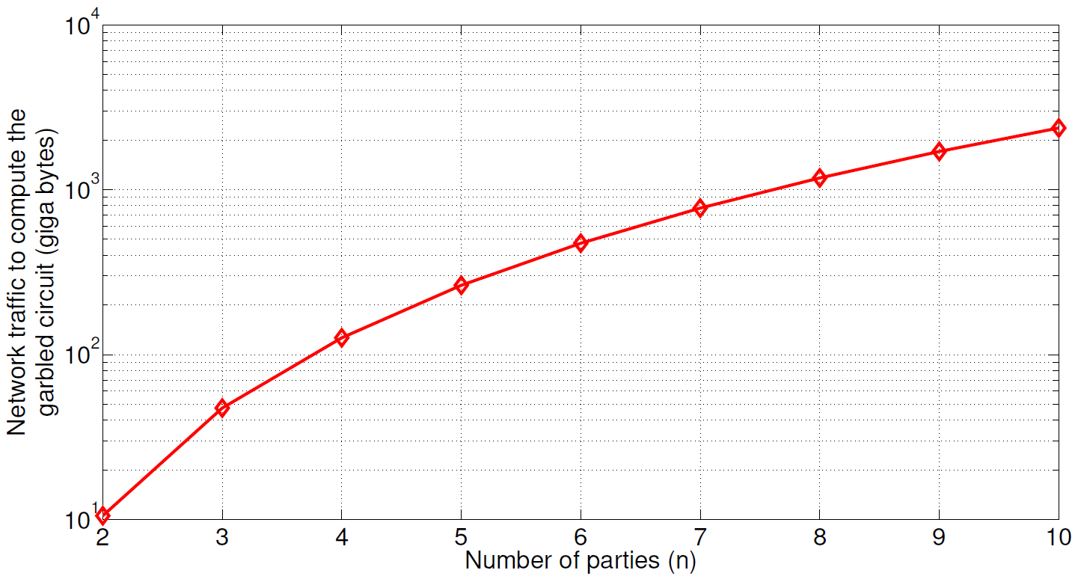
Server-Side Cost to Construct
Garbled Circuit for Closest ATM
To compute the closest ATM and distance, servers exchange 126 GB of information, when $n=4$, for example, while constructing the garbled circuit
Demonstrates feasibility of real-world privacy preserving computations!

Slide 15
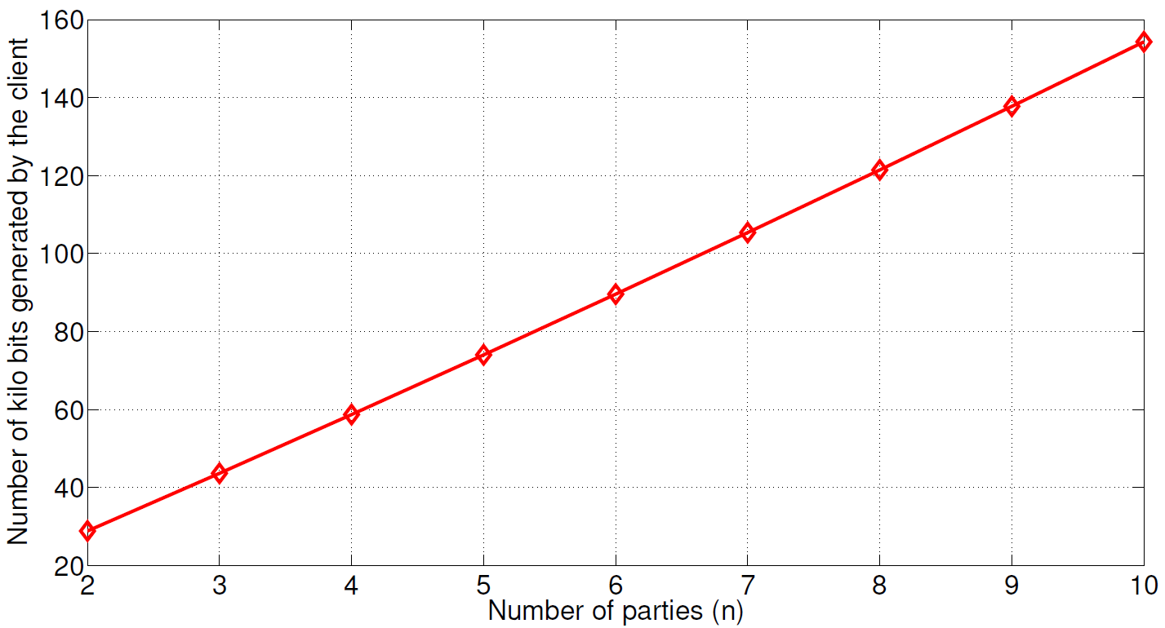
Client-Side Cost to determine
the Closest ATM
client-side cost grows much slowly with number of parties, in comparison to server-side cost!
Client sends seed values, and the coordinates of an intersection to the cloud servers
Public ATM locations are assumed to be hard-coded in the garbled circuit. i.e., client does not transmit ATM locations to the servers
To preserve location privacy, client exchanges very small amount of information with servers; less than 60 kilo bits, with $n=4$ servers, for example

Slide 16
Backup Slides
Alternative/Direct Method to Calculate Manhattan Distance

Slide 17
Maximum and Minimum Value [Huang’12]
$$u$$
$$v$$
Need to find both maximum and minimum of two numbers $u,v$
Let $l=\left|u\right|=\left|v\right|$
CMP block is composed of $l$ 1-bit comparators
Each 1-bit comparator is composed of 3 XOR gates, 1 AND gate
$$MAX_MIN$$
$$CMP$$
$$COND_SWAP$$
$$\max\left(u,v\right)$$
$$\min\left(u,v\right)$$
COND_SWAP block is composed of $3l$ XOR gates, $l$ AND gates
Minimum and Maximum Value Block
Block | #XOR gates | #AND gates
$$CMP$$ | $$3l$$ | $$l$$
$$COND_SWAP$$ | $$3l$$ | $$l$$
Total | $$6l$$ | $$2l$$

Slide 18
Manhattan Distance using $MAX_MIN$ block
$$x_{a}$$
$$x_{b}$$
$$y_{a}$$
$$y_{b}$$
Manhattan Distance
Block | #XOR gates | #AND gates
$$MAX_MIN$$ | $$6l$$ | $$2l$$
$$MAX_MIN$$ | $$6l$$ | $$2l$$
$$SUB$$ | $$4l$$ | $$l$$
$$SUB$$ | $$4l$$ | $$l$$
$$ADD$$ | $$4l$$ | $$l$$
Total | $$24l$$ | $$7l$$
$$MAX_MIN$$
$$MAX_MIN$$
$$\hat{x_{a}}$$
$$\hat{x_{b}}$$
$$\hat{y_{a}}$$
$$\hat{y_{b}}$$
$$SUB$$
$$SUB$$
$$\left|x_{a}−x_{b}\right|$$
$$\left|y_{a}−y_{b}\right|$$
$$ADD$$
$$\left|x_{a}−x_{b}\right|+\left|y_{a}−y_{b}\right|$$
Note: $\hat{x_{a}}≥x_{b};\hat{y_{a}}≥y_{b}$
Calculation of Manhattan distance using $MAX_MIN$ block requires $24l XOR, 7l AND gates$
Note: calculation shown in slide# 5 that uses 2 INV blocks & 1 INC block is more optimal, since it only requires $(15l+1) XOR, 4l AND gates$

