Slide 1
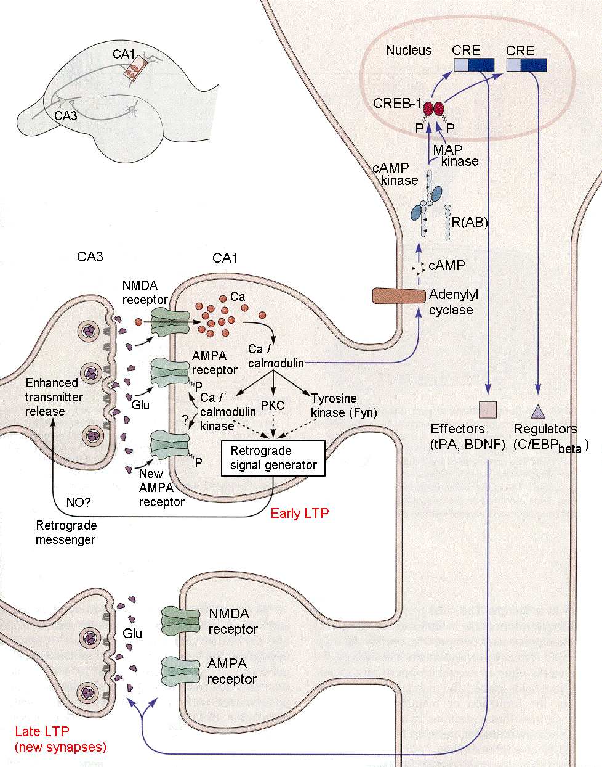
Learning at the Cellular Level
Justin Besant
BIONB 2220
Final Project
http://www.unmc.edu/physiology/Mann/mann19.html

Slide 2
Goal
How learning can occur at the cellular level?
How this be modeled and simulated quickly using the Izhikevich model?

Slide 3
Learning
Classical Conditioning
US, CS, UR, CR
Hebbian Learning
"When an axon of cell A is near enough to excite a cell B and repeatedly or persistently takes part in firing it, some growth process or metabolic change takes place in one or both cells such that A’s efficiency, as one of the cells firing B, is increased.” – Donald Hebb

Slide 4
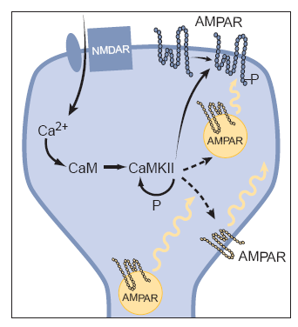
Long Term Potentiation
Long term increase in synaptic strength (hours – weeks)
Possible cellular explanation for learning and memory
NMDAR, AMPAR, Calcium
Robert C. Malenka, et al. “Long-Term Potentiation: A Decade of Progress?” Science. 285, 1870 (1999).

Slide 5
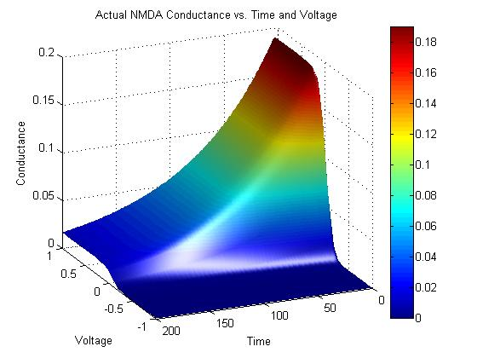
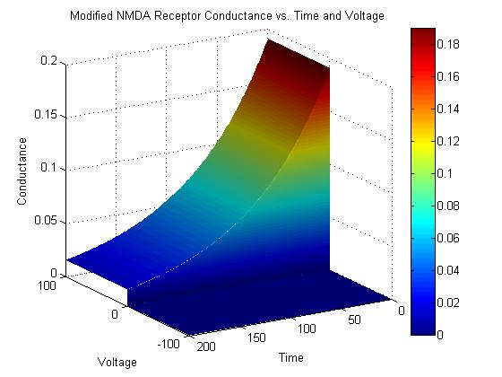
NMDA Receptors
Incorporate NMDA into the Izhikevich model
Coincidence detector
Voltage dependence of conductance
AMPA receptors and neurotransmitters
Saudargiene, Ausra, et. al. “Biologically Inspired Artificial Neural Network Algorithm Which Implements Local Learning Rules.” Proceedings of the 2004 International Symposium on Circuits and Systems. 5 (2004) 389-392.

Slide 6
Calcium
3rd Izhikevich state variable
Spike-timing-dependent-plasticity

Slide 7
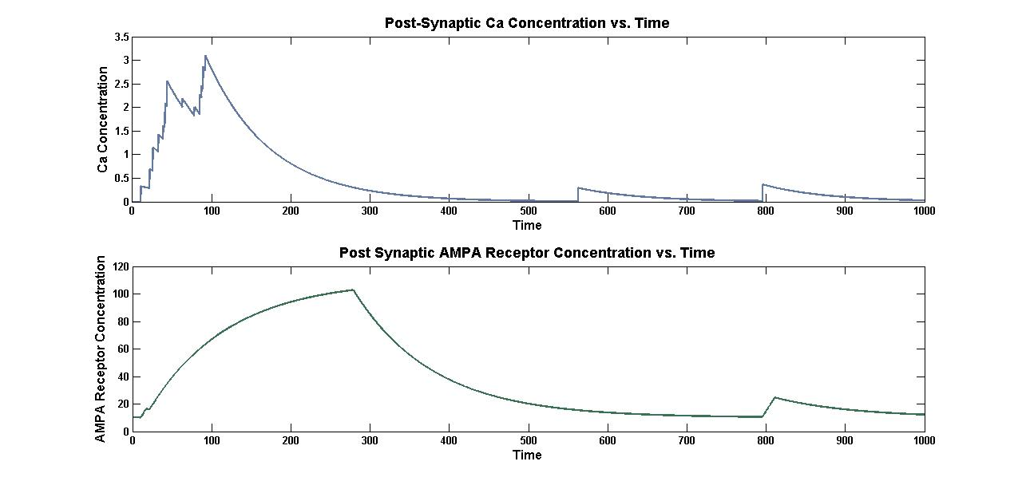
AMPA Receptors
Dynamically change concentration

Slide 8
LTP
Two ways to induce LTP
Simultaneous stimulation
Rapid and repetitive stimulation
Example of LTP:

Slide 9
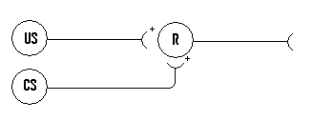
Classical Conditioning

Slide 10
Future Directions and Questions?
Epilepsy
“Learning gone wild?”
Kindling involves glutamate NMDA receptors

