Slide 1
Thermistor-Based Respiration Monitor
Hana Qudsi, Maneesh Gupta
Cornell University
School of Electrical and Computer Engineering
Notes:
Hi, my name is Hana Qudsi and I am a senior studying computer engineering at Cornell University. For our final project for our senior design course, my partner and I developed a Thermistor-Based Respiration Monitor

Slide 2
OVERVIEW
Respiration rate is a standard physiological measurement taken for monitoring a patient.
Existing respiration monitors used in traditional medical centers are unsuitable for low-resource environments.
A patient's breathing rate is calculated through temperature changes that occur when they breathe into a mask.
The device generates an alarm signal when the patient stops breathing
A low-battery indicator signal is generated when the battery powering the device dips below a threshold voltage.
Notes:
Respiration rate, which is how fast a person is breathing, is a standard physiological measurement taken for monitoring a patient.
Existing respiration monitors used in medical centers are unsuitable for low-resource environments.
- Require stable power supply
- Designed to be stationary
In designing our project we wanted to address these needs
A patient's breathing rate is calculated through temperature changes that occur when they breathe into a mask which has an embedded thermistor and microphone.
The device generates an alarm signal when the patient stops breathing
An additional feature of our device is a low-battery indicator signal that is generated when the battery powering the device dips below a threshold voltage.

Slide 3
HARDWARE DESIGN
Notes:
There are four major components of our hardware design

Slide 4
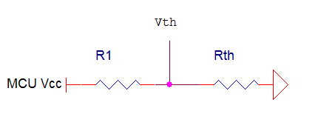
THERMISTOR MEASUREMENT
The microcontroller (MCU) samples the voltage across the thermistor using a voltage divider.
This is proportional to the respiration rate of the patient.
Notes:
The most important feature is how we sample the thermistor.
The voltage across the thermistor is proportional to the respiration rate of the patient, and produces a nice sinusoidal curve when a person inhales and exhales. The MCU samples this voltage using a voltage divider.

Slide 5
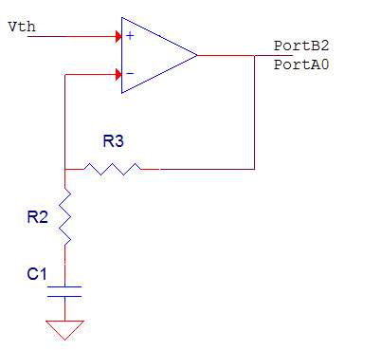
THERMISTOR AMPLIFICATION
The signal from the thermistor is on the order of 10 mV which is too small for the MCU sample.
An operational amplifier, with a gain of 4, is used to increase the resolution of the signal.
A time constant of 22 seconds is used to prevent noise from being amplified a high pass filter.
Notes:
We found the amplitude of the direct signal from the thermistor too small for the MCU to sample correctly, so we used an op amp with a gain of 4 to increase the resolution.
To prevent noise from also being amplified, we pass the thermistor signal through a high pass filter first

Slide 6
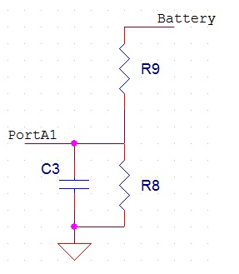
VOLTAGE MEASUREMENT
The voltage divider is used to convert the voltage range from 0-9V to 0-5V so that no damage is done to the MCU.
The low pass filter is to eliminate any high frequency signals that might occur.
Notes:
To implement our “low battery” indicator functionality we first low pass filter the voltage input from the battery.
We then use a voltage divider to convert the voltage range from a 0-9 V scale to 0-5 V to prevent damage to the MCU when it samples this voltage

Slide 7
ANALOG COMPARATOR
Used to compare the amplified voltage across the thermistor to a reference voltage
A low pass filter is use to automatically determine the reference voltage for a patient.
Notes:
The respiration rate is measured by using an analog comparator (AC) to compare the amplified voltage across the thermistor to a reference voltage.
Since the respiratory signal is approximately equivalent to a sine wave with a DC offset, the reference voltage is chosen to be at the DC offset.
This DC offset changes from patient to patient. For example an adult may have a stronger signal than an infant.
To automatically determine the reference voltage for a patient we use this low pass filter to average the value of the incoming signal.

Slide 8
SOFTWARE DESIGN
Microcontroller Unit
Battery
Push Button
Display
Thermistor
Speaker
Respiration Calculation
Microphone
Notes:
This is a high level diagram representing all the tasks we programmed the microcontroller to do
The microcontroller we used for this project was an AtMega1284p
-Samples battery about once a minute.
-Samples from thermistor about once a second
-If it detects 10 consecutive “no breaths” from the thermistor, meaning that the MCU samples are close in value, or flatlining, MCU takes a sample from the microphone to see if the patient is talking (or crying for babies). This was found to significantly reduce false positive alarms
-If the patient is determined not to be breathing or making noise, the MCU sends a PWM signal to the piezoelectric speaker to generate an alarm
Since a person’s breathing is not constant, it won’t be a perfect sinusoidal wave. For our respiration rate calculation, we calculate a weighted average the new sample taken with the previous respiration rate
-When a user pushes a button on the device, this respiration rate is displayed onto an LCD in breaths per minute

Slide 9
RESULTS
Measures respiration rate with error of less than 10%
Calibration and startup time is about 20 seconds
LCD only receives power when the display button is held down
Original breathing signal (bottom)
Filtered and amplified signal (top)
Original breathing signal (bottom)
Filtered and amplified signal (top)
Notes:
This graph show the original signal coming from the thermistor (at the bottom) and a filtered and amplified version at the top. The top signal is actually displayed on a different scale, so its amplitude is even greater than it seems
Our averaging algorithm calculates the respiration rate to be within 10% of its actual value
One of our design features to conserve battery power was to power the LCD only when a user actively wanted to see the patient’s respiration rate

Slide 10
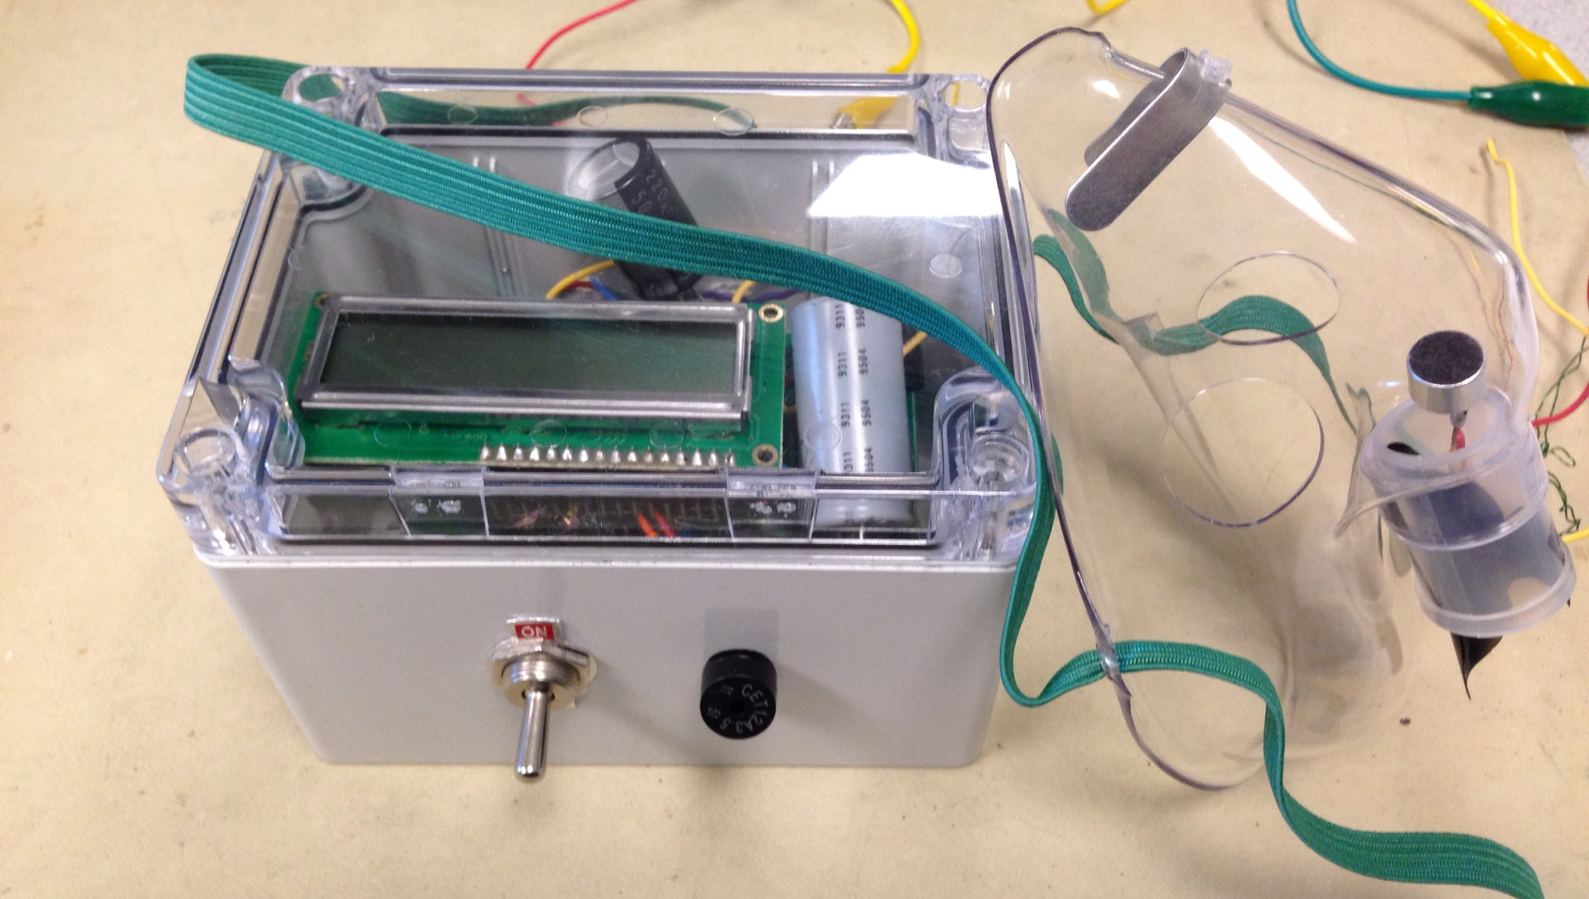
RESULTS (continued)
Piezoelectric speaker is activated when patient is not breathing or the battery is below 7.5V.
Alarm is automatically turned off when the patient begins to breathe again or makes noise

Slide 11
DEMO

Slide 12
QUESTIONS?
Additional details, as well as design schematics and source code can be found on our project page at: http://people.ece.cornell.edu/land/courses/ece4760/FinalProjects/f2012/htq2_mg573/htq2_mg573/index.htm
Notes:
THANK YOU

