Slide 1
Intro to Lab 3: Modeling a Microvascular Network on a Chip
BME1310
17.3.2011
Erik Zavrel

Slide 2
Lab Objective
To characterize a simple model of microvascular system using a microfluidic device AND
To introduce you to microfluidics
  Measure flow velocities within model network before and after a blockage (mimicking an occlusion of a blood vessel or clot like during a stroke) and track the redistribution of flow when a channel is occluded.
  Lab will be followed by a homework where you will theoretically calculate the pressure and velocity in each channel before and after blockage using MATLAB. You will then compare your calculated pressure and velocities with your measured velocities.

Slide 3
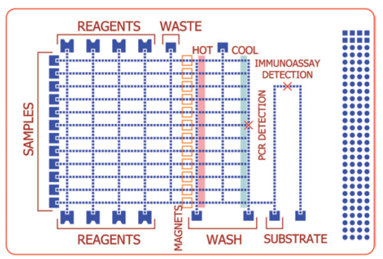
What is Microfluidics: What’s in a name?
Infer: manipulation of minute quantities of fluids (L and G) …
  inside devices made using advanced microfab tools (CNF).
  Applies ultra-precise fab technology to conventionally “messy” fields like biology (dishes, plates) and chemistry (vats, reaction vessels)
  New field – emerged early 90s: Andreas Manz, George Whitesides
  Why?
    Unique physics at microscale permits novel creations:
      Laminar flow
      High SA/V ratio – surface tension (droplet) >> gravity (sedimentation)
    Reduces amounts of reagents needed
    Permits more orderly, systematic approach to bio-related problems, reduces physical effort: drug discovery, cytotoxicity assays, protein crystallization (for x-ray crystallography)
    Disposable, parallel operation, increased reliability
  Applications:
    Biomimesis, diagnostic devices, biosensors, cell sorting, enrichment, storing

Slide 4
Examples of Microfluidics
LSI
Body on chip
Concentration gradient
Sperm sorter for IVF
Portable medical diagnostics
Traction force microscopy

Slide 5
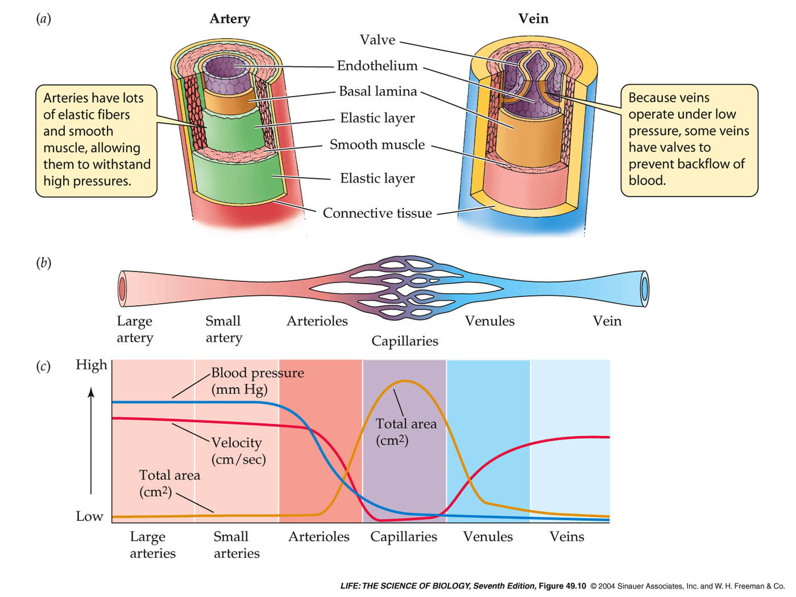
Your Microfluidic Device
Mimics this

Slide 6
Procedure: Before Clot
PDMS devices made for you
Fill syringe with bead (10um dia.) solution
Connect needle to syringe
Connect tubing to needle
Place syringe in syringe pump
Flow @ 50uL/min to flush out bubbles
Reduce flow rate to 1-5uL/min
Capture series of images to track beads in each channel of device
  V = d/t

Slide 7
Procedure: Clot
Disconnect device from pump
Using empty syringe, introduce air to dry device
Punch hole in desired channel with punch
Remove plug of PDMS
Inject sealant to block channel
Cure @ 60C for 10min
Repeat process: track beads in each channel

Slide 8
How Many Channels?
6
5
2
1
8
9
3
4
7

Slide 9
Results and Data Analysis Expected
Average velocity for each channel before blockage
Average velocity for each channel after blockage
Prediction of flow pattern after channel blockage
Bead Motion Analysis:
  Want to track at least 10 beads in each channel
  Track beads in each channel over several frames
  Not interested in instantaneous velocity of beads (changes from frame to frame)
  Interested in average velocity (total distance traveled / time observed)
  Bin data to generate histogram (data partitioned into intervals and frequency of occurrence plotted)

Slide 10
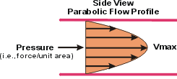
Note on Bead Motion
In pressure-driven flow, velocity profile of fluid is parabolic:
Velocity is maximum in center of channel
Velocity is minimum near walls of channel

Slide 11
Report Guidelines
Title Page
Abstract
Introduction
Materials and Methods
Results
Discussion
Questions
Place raw data in appendix
Place processed, presentable data in body of report
Cite at least 3 sources posted on Blackboard
MATLAB session to be held in Carpenter tentatively set for Fri April 15th
ImageJ covered in lab
Due Thursday 14th of April in class
Bring USB to save large data files!

Slide 12
Analysis: Circuit Analog
In analyzing a microfluidic device, it is useful to make an analogy to an electrical circuit:
Pressure → Voltage
Flow Rate → Current
Hydraulic Resistance → Electrical Resistance
Volumetric flow rate = average linear velocity * cross-sectional area of channel
Ohm’s Law:
  V = IR
  Pressure = Volumetric Flow Rate * Channel Resistance
Ground = reference potential → same pressure
KCL:
  Conservation of charge → conservation of mass:
    Flow rate into a node MUST equal flow rate out of that node
    Nothing collects at node
Convention: Define flow into node as + and flow out of node as –
I₁ + i₂ – i₃ = 0
1₃ = i₁+i₂
i₁ →
←i₂
i₃ ↓

Slide 13
Circuit Analysis
Resistances are either in series or parallel
Series:
R_{T} = R₁+R₂+R₃ = 1000+2000+3000 = 6000 ohm
Sum is ALWAYS greater than any single resistance
Parallel:
R_{T} = 1 / (1/R₁ + 1/R₂ + 1/R₃) = 1/ (1/1000 + 1/2000 + 1/3000) = 545 ohm
Sum is ALWAYS less than any single resistance
Special Case: 2 in parallel:
R_{T} = R₁*R₂ / (R₁+R₂)

Slide 14
Example: Resistance Network

Slide 15
1. R1 and R2 in series = 6k

Slide 16
2. R3 and R4 in series = 500 ohm

Slide 17
3. 500 ohm in parallel with 1500 ohm = 375 ohm

Slide 18
Remaining resistors in series = 6000 + 375 + 250 + 400 = 7025 ohm

Slide 19
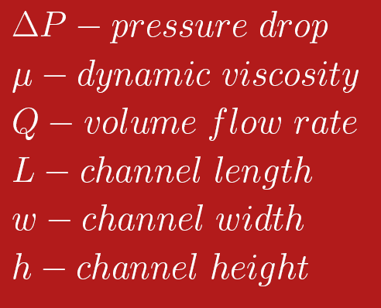
Pressure Drop Along Channel
Equation valid only if w >>h

Slide 20

Pressure Drop Along Channel

Slide 21
Fabrication: How Are Microfluidic Devices Made?
Pattern is defined on surface (2D) and then transferred into vertical plane
Process flow – depicted as a cross-sectional view, each step showing execution of one step (addition of layer, exposure, removal of layer, etc.)

Slide 22
Process Flow: Soft-Lithography
1) Spin SU-8
4) Apply Anti-stick monolayer
SU-8
Si
2) Expose
5) Cast PDMS
mask
2) Expose
Mask
6) Plasma treat + bond
3) Develop
glass

Slide 23
END

