Slide 1
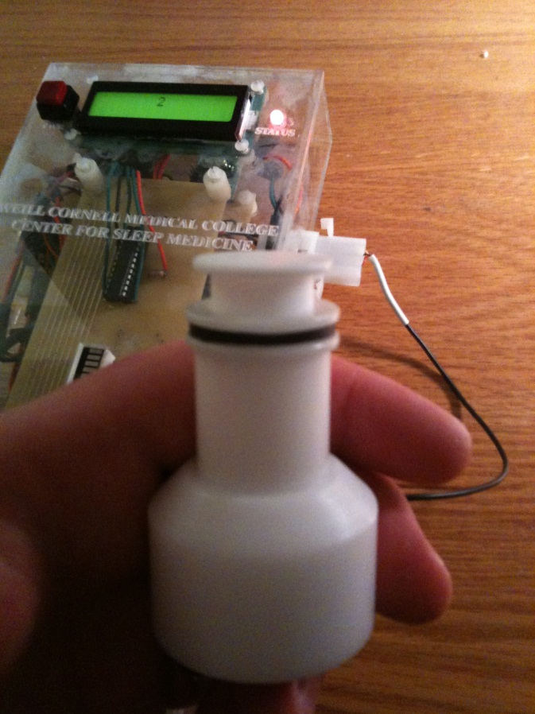
Project: Feedback Systems for Alternative Treatment of Obstructive Sleep Apnea
Idea:
Create auditory and visual feedback systems to relate the amount of force back to the person exerting the force
Potential uses:
Biomedical training device
Superior to existing treatment?
Components:
Microcontroller
Resistor
Light emitting diodes (LEDs)
Transistor
Peizo Buzzer
Analog-to-digital converter (ADC)
Digital potentiometer
Force sensor (load cell)

Slide 2
Background
Obstructive sleep apnea (OSA) is the most common type of sleep-disordered breathing. It is characterized by unusual pauses or cessations in breathing during sleep.
It is caused by a physical obstruction of the airway.

Slide 3
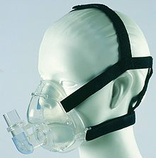
Current Treatment Options for Obstructive Sleep Apnea
The most common treatment is an assisted breathing device called a continuous positive airway pressure (CPAP) mask, designed to keep the upper airway open during sleep.
A seal is maintained by inserting tubes into the nose and securing the mask with straps around the patient’s head.
In appearance, a CPAP mask resembles a gas mask.

Slide 4
Shortcomings of Existing Treatment Options
CPAP devices are costly and cumbersome.
Many people fail to acclimate to the use of CPAP, often citing comfort issues as a reason for abandoning the device.
Some people are claustrophobic and are uncomfortable wearing a mask.
People also may not adjust to having to breathe out against positive pressure resistance.

Slide 5
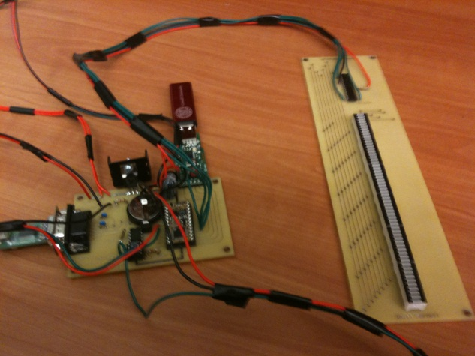
Proposed Alternative
The alternative treatment for obstructive sleep apnea consists of an electromechanical physical therapy device designed to increase the strength of a person’s tongue, or genioglossus.
The patient will train with this device while awake.
The hypothesis is that a stronger tongue will serve to hold open a person’s upper airway (increase upper airway patency) while asleep.

Slide 6
Importance of Feedback
To be utilized as a medical training device, it is vital that the device communicate with the user.
Simply having a patient press his tongue against a force sensor would make for a very poorly designed medical device.
By providing feedback to the patient, particularly in real time, a device could make training much more effective.
Whether by some visual indication or an auditory cue, the user must know if they are succeeding in exerting more force.

Slide 7
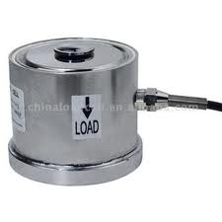
Load cell
Force sensor
Output signal is analog voltage - increases as more force is applied
3 wires: power, ground, signal

Slide 8
Analog/Digital Converter
An analog-to-digital converter (ADC) is an integrated circuit that converts a continuous signal into a discretized signal understandable by computers.
The quality of an ADC is determined by how many bits with which it approximates the analog signal.
A 1-bit ADC can represent data as either on or off.
A 4-bit ADC can provide 16 (2⁴) graduations: white, black, and 14 shades of gray.
A 12-bit ADC can approximate an analog signal with 4096 (2¹²) degrees.
Specifically, a 12-bit ADC has 16 times the resolution as an 8-bit ADC (2¹²/2⁸ = 2⁴).
Resolution is the ability to differentiate or distinguish between two closely spaced objects or two signals of nearly the same value. A 12-bit ADC may be able to differentiate between 4.25V and 4.24V, but an 8-bit ADC may not.

Slide 9
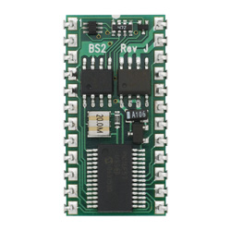
Microcontroller
A microcontroller is a miniature computer. It has a processor and memory.
Like a computer, a microcontroller is designed to interact with other devices.
It can receive input and send output.
By programming a microcontroller to read data from sensors and to control actuators and output devices, a much more capable and reliable device can be created.

Slide 10
Your Mission…
You are tasked with designing and implementing four different feedback displays for the proposed alternative treatment for obstructive sleep apnea and assessing which one is most effective at communicating the force a patient is exerting back to the patient.

Slide 11
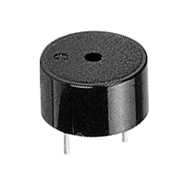
Auditory
Using a piezo buzzer, build a device that will relate force by changing pitch:
When the patient exerts more force, the buzzer should increase in frequency (or pitch)
When the patient exerts less force, the buzzer should decrease in frequency (or pitch)

Slide 12
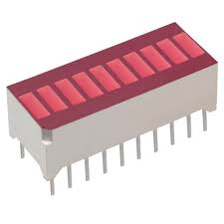
Visual 1
Use an LED bargraph (an array of 10 LED segments in one package) to display the current force to the patient:
As the patient exerts more force, more lights should come on
When the patient exerts less force, fewer lights should be on

Slide 13
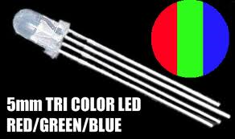
Visual 2
Make an LED change color as the force the patient exerts changes:
Use a tricolor LED to represent the force the patient is exerting.
Will your LED change color abruptly, switching from red to orange? Or will it change color gradually, from red to reddish orange to orange?

Slide 14
Visual 3
Use the force the patient is exerting to control the brightness of an LED:
As the patient exerts more force, the light should grow brighter
When the person exerts less force, the light should grow dimmer.
Hint: You can achieve this using either a software-based or hardware-based approach. Attempt both.
For the hardware approach, use a digital potentiometer to control a single LED.
For the software approach, you will need to use pulse width modulation (PWM).
PWM means very quickly changing from a high to low state and precisely controlling the amount of time spent at a high state and at a low state.

Slide 15
Tips/Hints
Tackle this project in steps, not all at once.
Progress from one part to another in a logical manner.
First succeed in connecting the force sensor to the microcontroller and confirming that you are able to read force values from the sensor.
What is the lowest force reading (when patient is not pressing)? Is it exactly zero? If not, how will you deal with it? What is the highest force reading (corresponding to the patient exerting a very large force)? What is the range of the force data to display?
Next, learn how to control the piezo buzzer and visual indicators.
Next, use the input from the force sensor to control the indicators.
How do you want to relate the input force to the auditory or visual cues?
Should there be a linear relationship?
An exponential relationship?
A continuous relationship, meaning for every unique force reading, a unique output results?
A discrete relationship, meaning that if the input force falls within a certain range or bracket, the same output results?

Slide 16
To Get You Started
Digitizes force data to be read by microcontroller
Code to get data from ADC will also be provided

