Slide 1
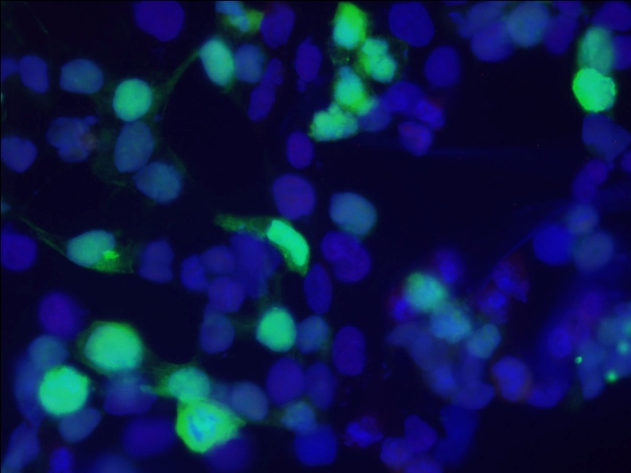
Project: Protein Localization in Mammalian Cells
Idea: Compare localization of proteins (ZFP568 & GALT) in two types of mammalian cells
Significance: Protein location is essential for proper function, mislocalization is associated with disease
Biological Techniques:
DNA extraction & purification
Transfection of DNA into HEK293T (human embryonic kidney) & NIH3T3 (mouse embryonic fibroblast) cells
Cell staining & fluorescence microscopy to visualize protein location with GFP
Notes:
Protein location within cells
Proteins have jobs and homes within the cell!
Proteins have to be in the right place to do their job…or things go wrong

Slide 2
Diseases associated with Protein Mislocalization
Cystic fibrosis (CF)
Familial hypercholesterolaemia (FH)
Congenital sucrase-isomaltase deficiency (CSID)
Notes:
Alzheimer’s disease as well?
Do more research into diseases!!!

Slide 3
Project Goal
Compare the localization of two proteins (ZFP568 & GALT) in two types of mammalian cells (human embryonic kidney cells & mouse embryonic fibroblasts)
We’ll do this by
Making DNA that codes for our proteins (DNA extraction & purification)
Putting that DNA in mammalian cells (transfection)
Determining where our proteins are within the cells (cell staining & fluorescent microscopy)

Slide 4
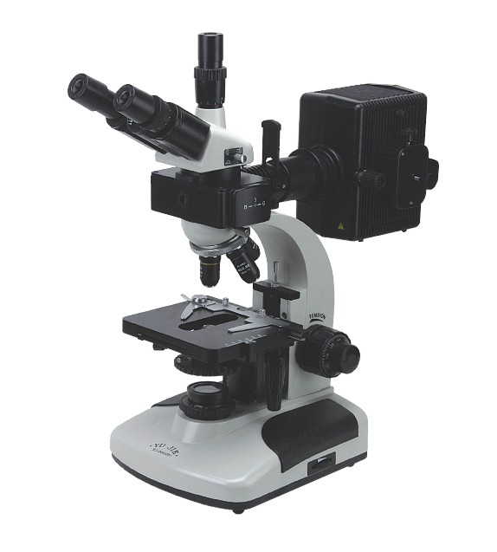
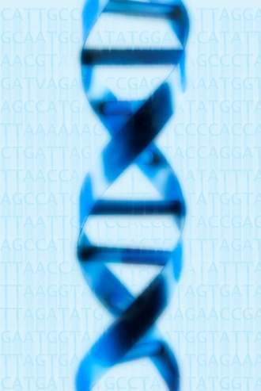
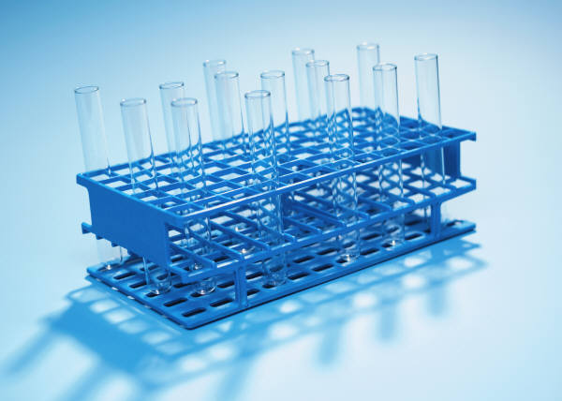
Our Project Plan
Stain & look at our cells to see where the protein is (Thurs/Fri)
Miniprep to extract DNA from bacteria (Tues)
Transfect to put our DNA in mammalian cells (Wed)
Notes:
Tools We Can Use:
-Bacteria to make a lot of our DNA
-DNA extraction from bacterial cultures
-Transfection of DNA into mammalian cells
-Staining for different parts of cells
-Using fluorescent microscope to look at the GFP-tagged proteins & other staining (for nucleus and cytoskeleton)

Slide 5
The Two Cell Types We’ll Use
HEK293T cells (human embryonic kidney)
Good for transfections
Sturdy cells, but small (not much cytoplasm)
NIH 3T3 cells (mouse embryonic fibroblast)
Not as good for transfections
But bigger (more cytoplasm)
Notes:
More info about each cell type
Ask about why bigger is better for our particular project – looking at localization so we want to see the inside of each cell very well

Slide 6
The Two Proteins We’ll Look At
GFP-ZFP568 (Zinc finger protein 568)
Transcription factor important in mouse development
GFP-GALT (Galactose-1-phosphate uridylyltransferase)
Enzyme important for converting galactose to glucose
Notes:
Transcription factor – alters expression of specific genes that code for specific proteins
We’ll be figuring out where these proteins are within the cell (e.g. nucleus, cytoplasm, etc)

Slide 7
GFP vector – a “plasmid”
Notes:
GFP (green fluorescent protein) – use as a tag so we can see where our protein ends up in the cells
Map of the GFP plasmid (a circle of DNA) – MCS (multiple cloning site) – where we put ZFP568 and GALT

Slide 8
Restriction Enzymes
Digestions and Ligations
Allowed us to put the DNA coding for ZFP568 or GALT in the GFP vector

