Slide 1
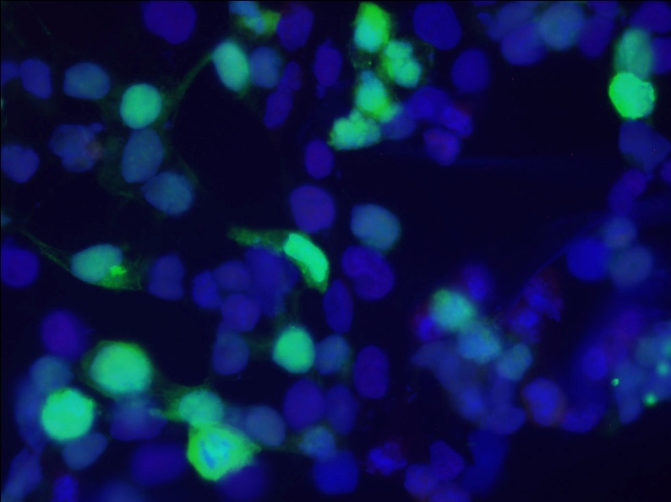
Project: Protein Localization in Mammalian Cells
Idea: Compare localization of proteins (ZFP568 & GALT) in two types of mammalian cells
Significance: Protein location is essential for proper function, mislocalization is associated with disease
Biological Techniques:
DNA extraction & purification
Transfection of DNA into HEK293T (human embryonic kidney) & NIH3T3 (mouse embryonic fibroblast) cells
Cell staining & fluorescence microscopy to visualize protein location with GFP

Slide 2
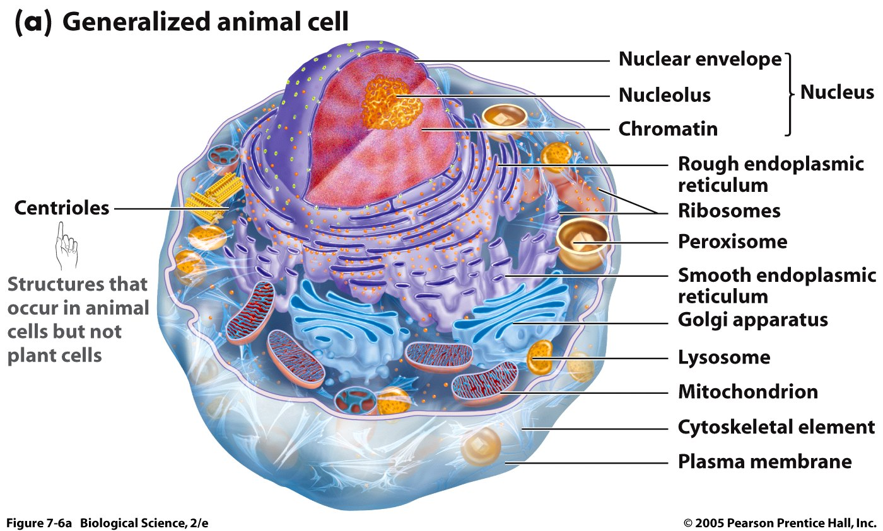
Protein Synthesis in the Cell

Slide 3
Diseases associated with defects in protein transport
Cystic fibrosis (CF)
Familial hypercholesterolaemia (FH)
Congenital sucrase-isomaltase deficiency (CSID)

Slide 4
Project Goal
Compare the localization of two proteins (ZFP568 & GALT) in two types of mammalian cells (human embryonic kidney cells & mouse embryonic fibroblasts)
We’ll do this by
Making DNA that codes for our proteins (DNA extraction & purification)
Putting that DNA in mammalian cells (transfection)
Determining where our proteins are within the cells (cell staining & fluorescent microscopy)

Slide 5
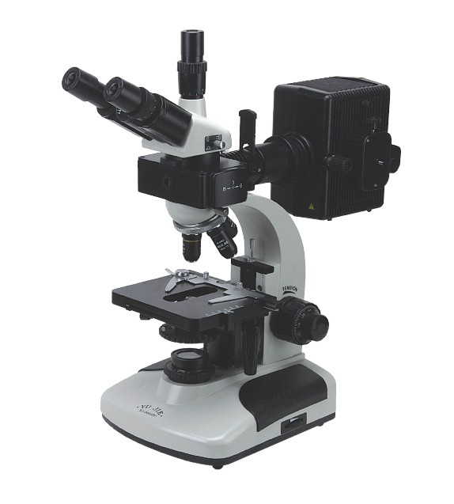
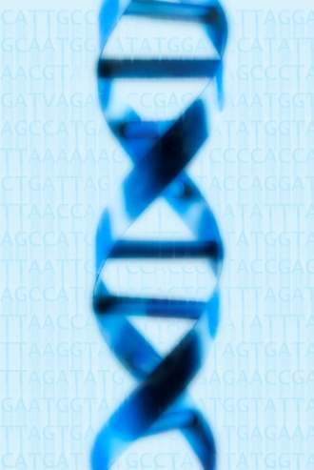
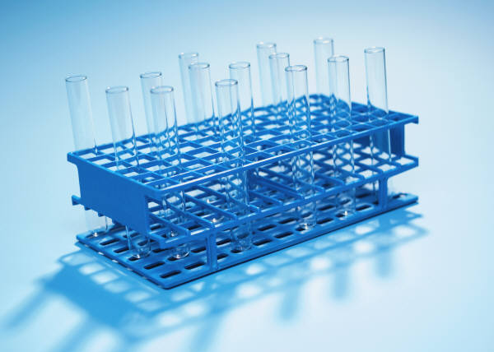
Our Project Plan
Stain & look at our cells to see where the protein is (Thurs/Fri)
Miniprep to extract DNA from bacteria (Tues)
Transfect to put our DNA in mammalian cells (Wed)
Notes:
Tools We Can Use:
-Bacteria to make a lot of our DNA
-DNA extraction from bacterial cultures
-Transfection of DNA into mammalian cells
-Staining for different parts of cells
-Using fluorescent microscope to look at the GFP-tagged proteins & other staining (for nucleus and cytoskeleton)

Slide 6
The Two Cell Types We’ll Use
HEK293T cells (human embryonic kidney)
NIH 3T3 cells (mouse embryonic fibroblast)
Look at the cell morphology of each: How are they different?
Which cell type would you want to use for our project?

Slide 7
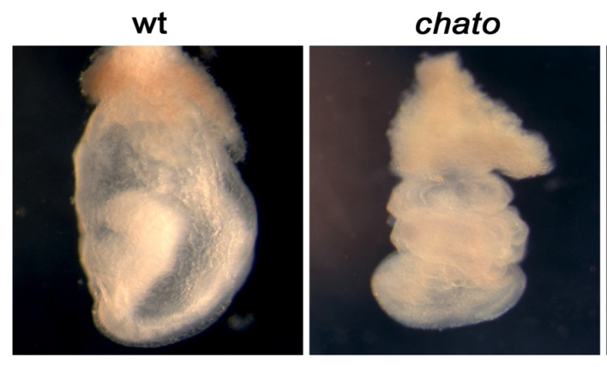
The First Protein We’ll Look At
GFP-ZFP568 (Zinc finger protein 568)
Binds to DNA and recruits transcriptional repressor TRIM28
Mutation (“chato”) causes embryonic arrest
Garcia-Garcia, M.J., Shibata, M., and Anderson, K.V. (2008). Development 135, 3053-3062.

Slide 8
The Second Protein We’ll Look At
GFP-GALT (Galactose-1-phosphate uridylyltransferase)
Enzyme important in sugar metabolism:
Converts galactose to glucose
Mutation in GALT causes galactosemia
autosomal recessive mode of inheritance

Slide 9
GFP vector – a plasmid
DNA coding for ZFP568 or GALT can be inserted here
Notes:
GFP (green fluorescent protein) – use as a tag so we can see where our protein ends up in the cells
Map of the GFP plasmid (a circle of DNA) – MCS (multiple cloning site) – where we put ZFP568 and GALT

Slide 10
Restriction Enzymes
XhoI and HindIII
Used to cut (digest) DNA coding for ZFP568 so it could be glued (ligated) into GFP-vector
Digest with these enzymes and DNA coding for ZFP568 should be “cut” from its vector
Resulting fragments of DNA will be analyzed using gel electrophoresis
What will this gel look like? How will digested GFP-ZFP568 look different from GFP-alone?
XhoI
HindIII
Notes:
So what would happen if you cut GFP-ZFP568 with XhoI and HindIII? → ZFP568 would pop out → two DNA fragments, one the leftover vector backbone and the smaller one the ZFP568 insert

Slide 11
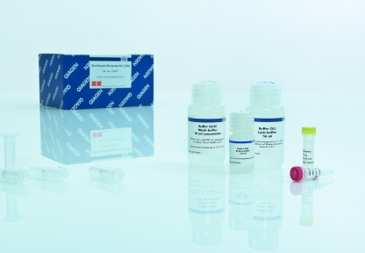
DNA extraction & purification
GFP-ZFP568, GFP-GALT, and GFP-alone DNA was transformed into bacterial cells → cells were cultured to make more DNA → now DNA can be extracted
Qiagen MiniPrep Kit

Slide 12
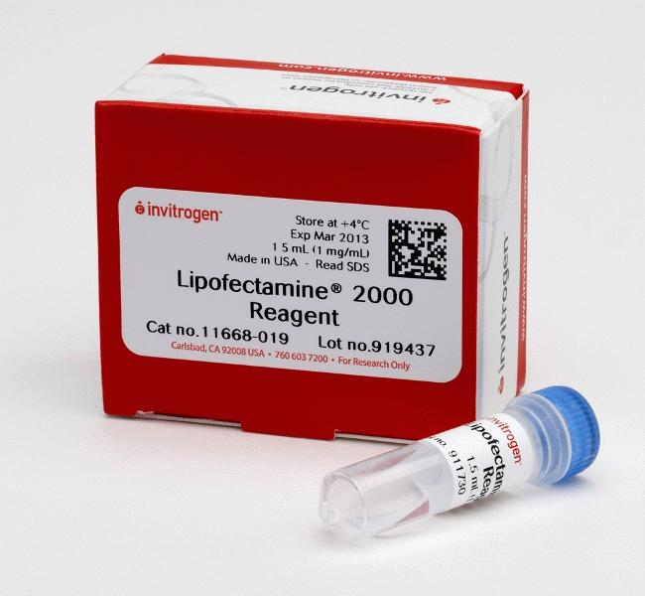
Transfection
Purified DNA can be transfected into HEK293T and NIH3T3 cells using Lipofectamine 2000
Mix DNA in media with the Lipofectamine reagent and then add it to your cells’ dish
Cells will take up DNA and express the proteins (GFP-ZFP568, GFP-GALT, or GFP-alone) within 24hrs
Why do we transfect the GFP-alone construct?

Slide 13
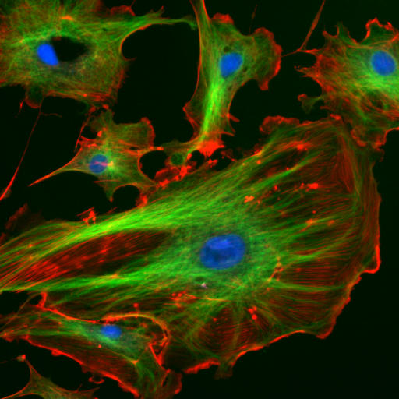
Cell Staining
Phalloidin (red)
Marks actin filaments, concentrated beneath cell membrane to keep cell shape
Actin is part of cytoskeleton
DAPI (blue)
Marks the nuclei of cells
GFP (green)
Tagged to ZFP568 and GALT
Can take pictures of each using fluorescence microscope and then merge using Photoshop
Why do we stain with DAPI and Phalloidin?
Why don’t we have to stain to see ZFP568 or GALT?
http://migration.wordpress.com/2007/07/11/basics-the-cytoskeleton/
Notes:
Why do you think we stain for phalloidin and DAPI? → helps us locate the proteins, without these references we wouldn’t be able to distinguish cell compartments

Slide 14
Final Questions
Where is GFP-GALT and GFP-ZFP568 located within the cell? Why?
What does GFP-alone look like? Why?
Is protein location different in HEK293T or NIH3T3 cells?
Why are cells useful for scientists?

