Slide 1
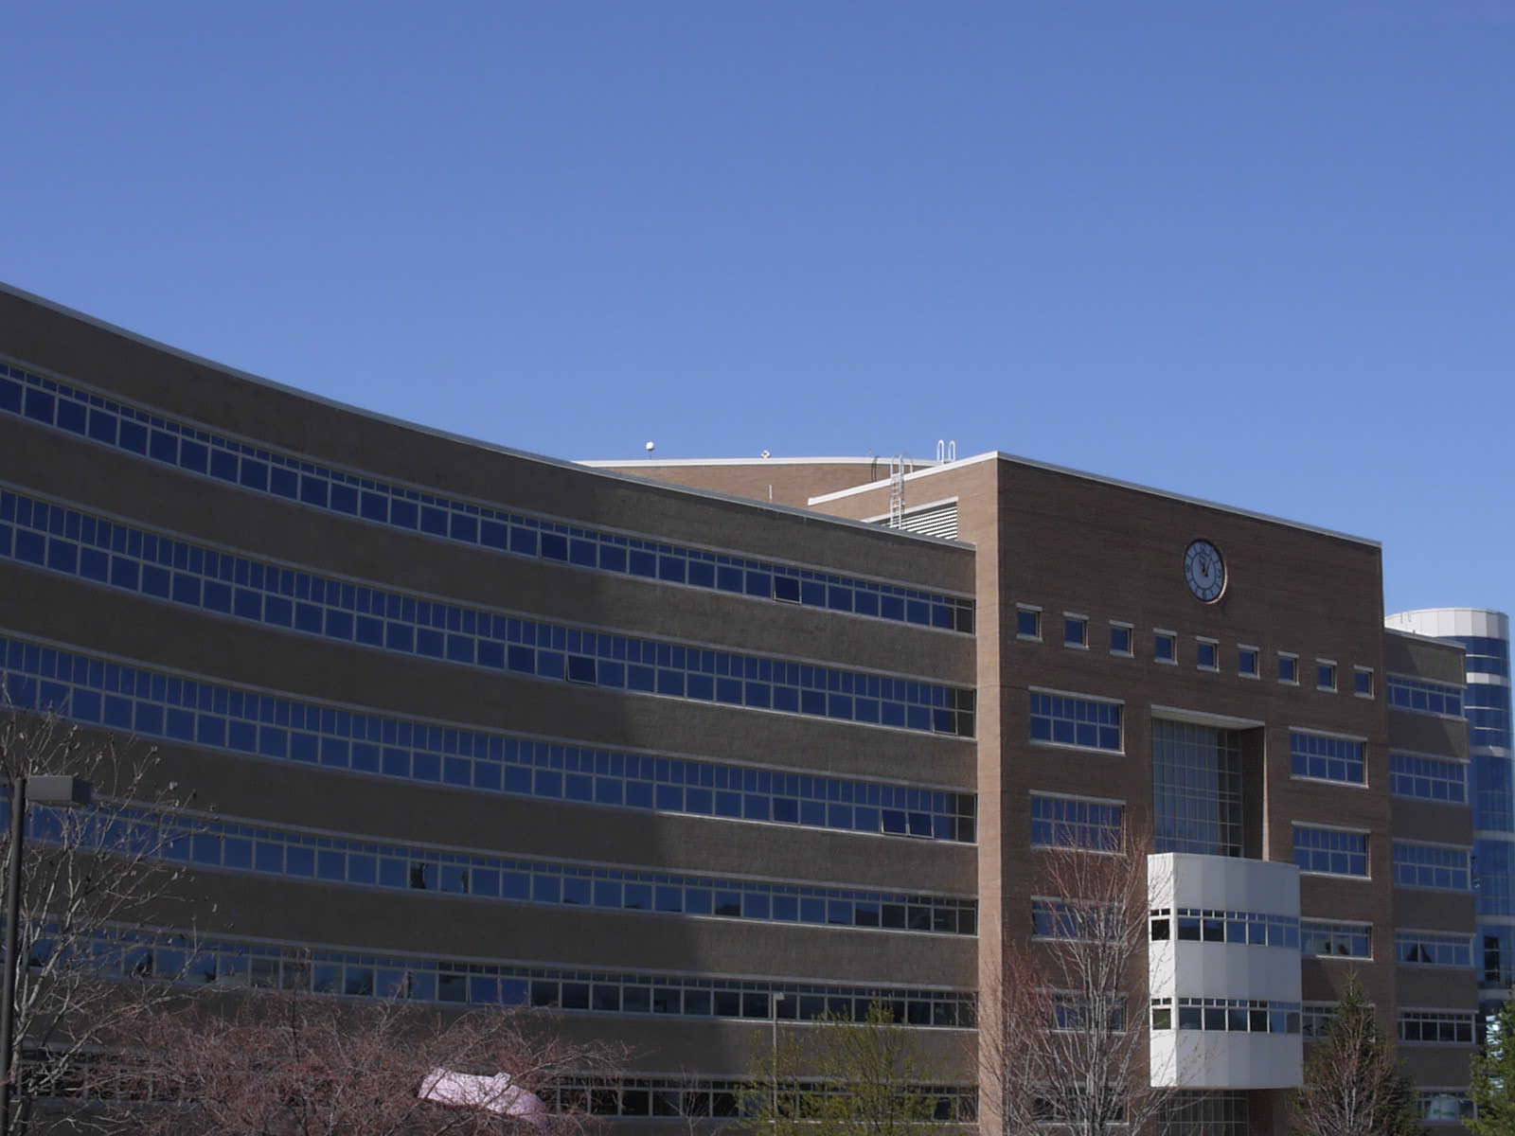
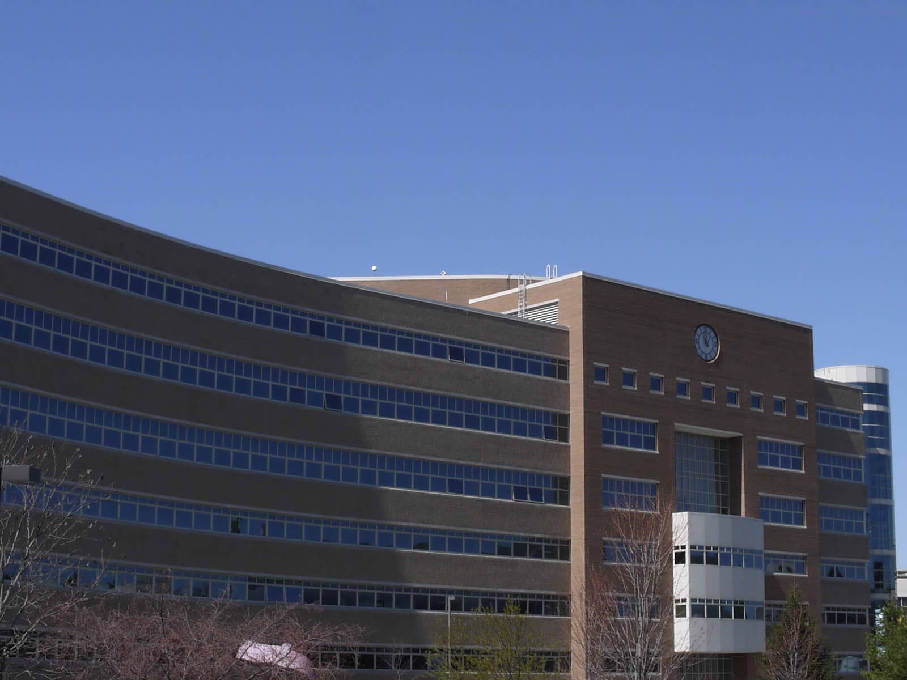
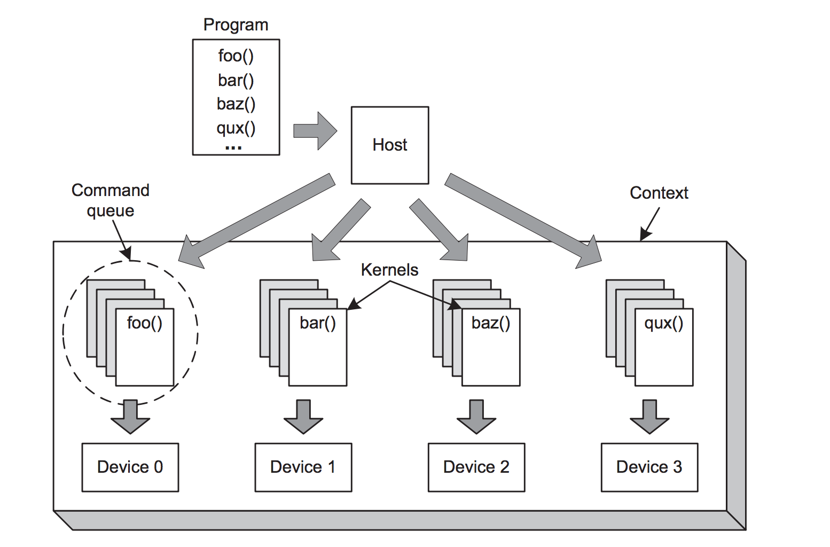
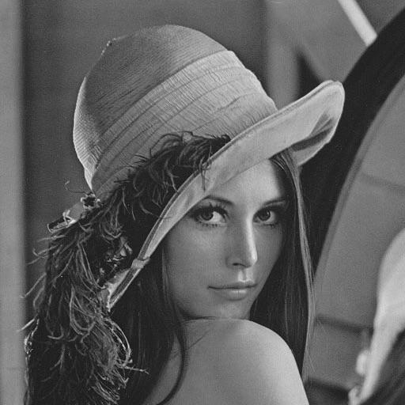
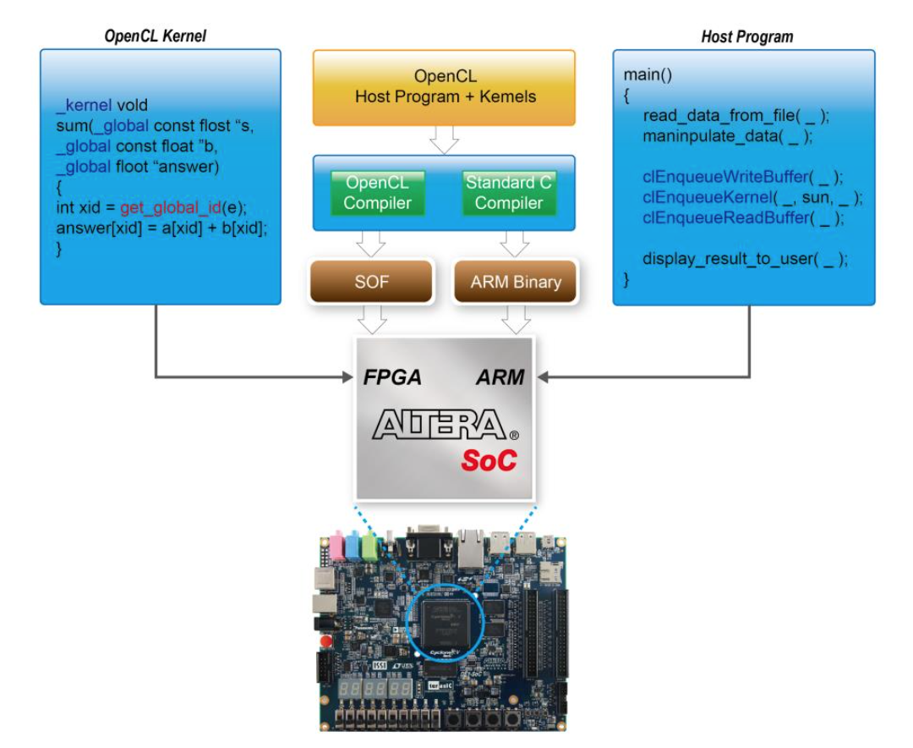
3D Stereoscopic Image Analysis
Using OpenCL on FPGA
Ahmed Kamel, Aashish Agarwal
Advisor: Dr. Bruce Land
Introduction
Goal
Low Cost
Fast
Experiencing OpenCL on FPGA
Energy Efficient
Process
Take in a stereoscopic image pair from a stereoscopic lens and feed it into an FPGA
The FPGA will analyse the image pair and run them through a series of algorithms
Results of the algorithms will be used to generate a pixel map that will be used to display a 3D image on the VGA screen
Implementation
Used OpenCL to exploit the parallelism available within the filtering algorithms
Results
Stereoscopic Image Pair
Input Image Gaussian Filter Bilateral Filter
Timing -------Guassian Filter FPGA------- -------Bilateral Filter FPGA-------
50 iterations time: 29.617 S 50 iterations time: 38.649 S
Average single iteration time: 0.592 S Average single iteration time: 0.773 S
Throughput = 1.688 FPS Throughput = 1.294 FPS
-------Guassian Filter ARM------- -------Bilateral Filter ARM-------
50 iterations time: 110.731 S 50 iterations time: 179.574 S
Average single iteration time: 2.215 S Average single iteration time: 3.591s
Throughput = .452 FPS Throughput = 0.278 FPS
FPGA
ARM
Process of reading in the image will be done by the ARM core
FPGA
Filtering, and depth extraction will be done on the FPGA
Theory
Stereoscopic image pair
The input image from the stereoscopic lens
Bilateral Filter
Addresses the issue of preserving object outer edges, and smooth inner edges
Depth Extraction
Sum of squared cross coraleation using small square regions to determine differences and calculate depth map
Conclusion and Future Works
The final results of the project are still under evaluation, and will be available in a couple of days. For the future, we plan to expand this project to take in a live video feed from the camera
References
Tomasi, C.; Manduchi, R., "Bilateral filtering for gray and color images," Computer Vision, 1998. Sixth International Conference on , vol., no., pp.839,846, 4-7 Jan 1998
C. Georgoulas, et al. "Real-time disparity map computation module." Microprocessors and Microsystems, 32, pp.159-170, 2008.
C. Murphy, et al. "Low-Cost Stereo Vision on an FPGA." International Symposium on Field-Programmable Custom Computing Machines, pp.333-334, 2007.
DE1SoC OpenCL_v02, http://www.terasic.com.tw/attachment/archive/836/DE1SOC_OpenCL_v02.pdf
"A Gentle Introduction to OpenCL." Dr. Dobb's. N.p., 03 Aug. 2011. Web. 29 Apr. 2015.
Notes:
Copyright Colin Purrington (http://colinpurrington.com/tips/academic/posterdesign).
‹#›

